Slide 1


Thanksgiving

Slide 2


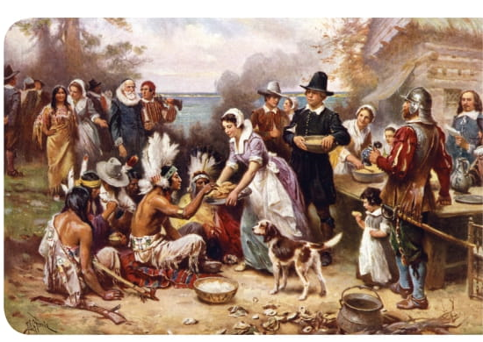


Slide 3
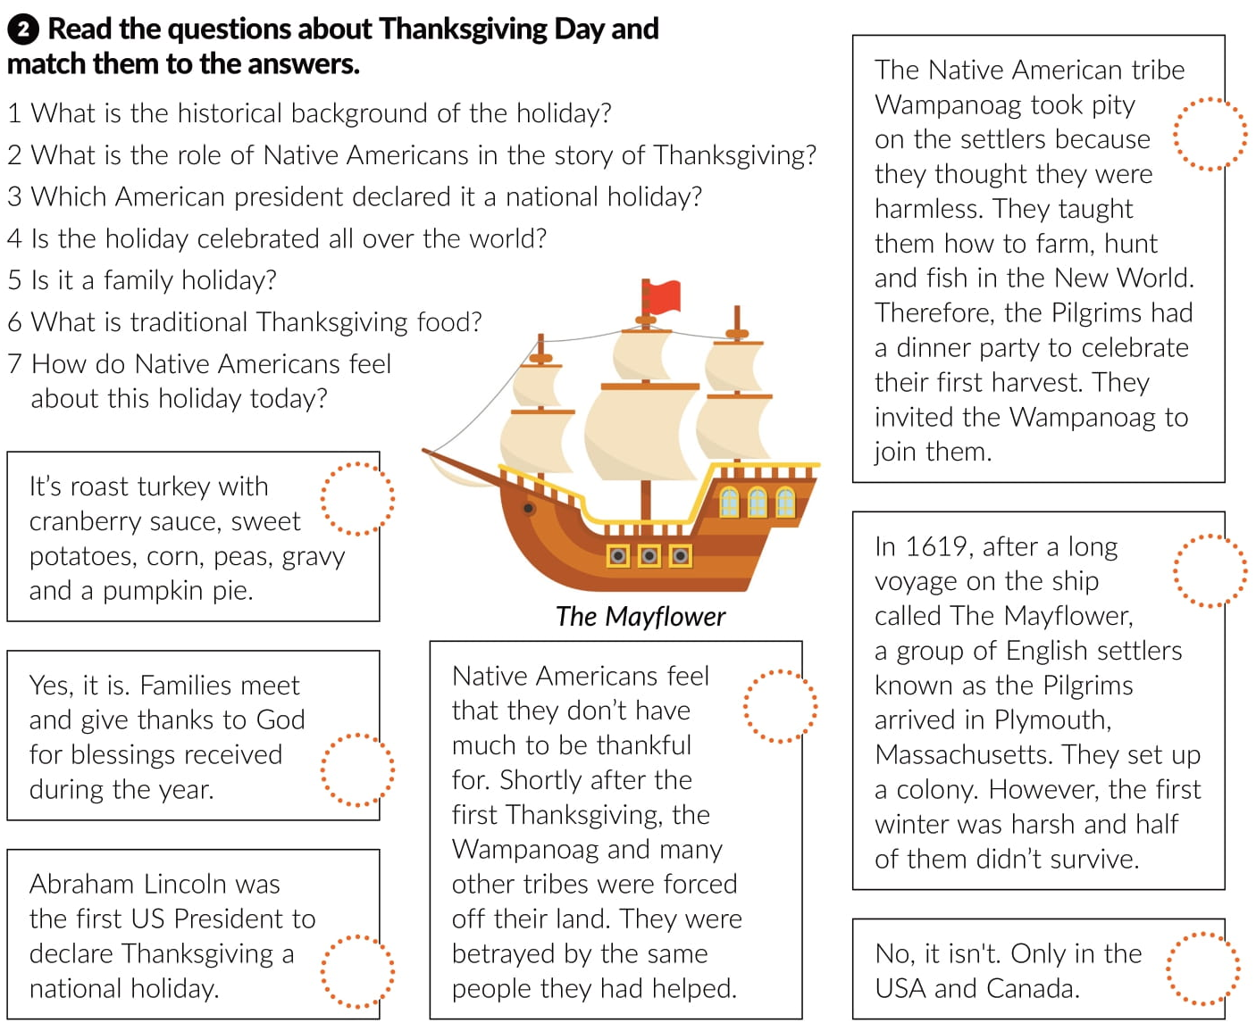
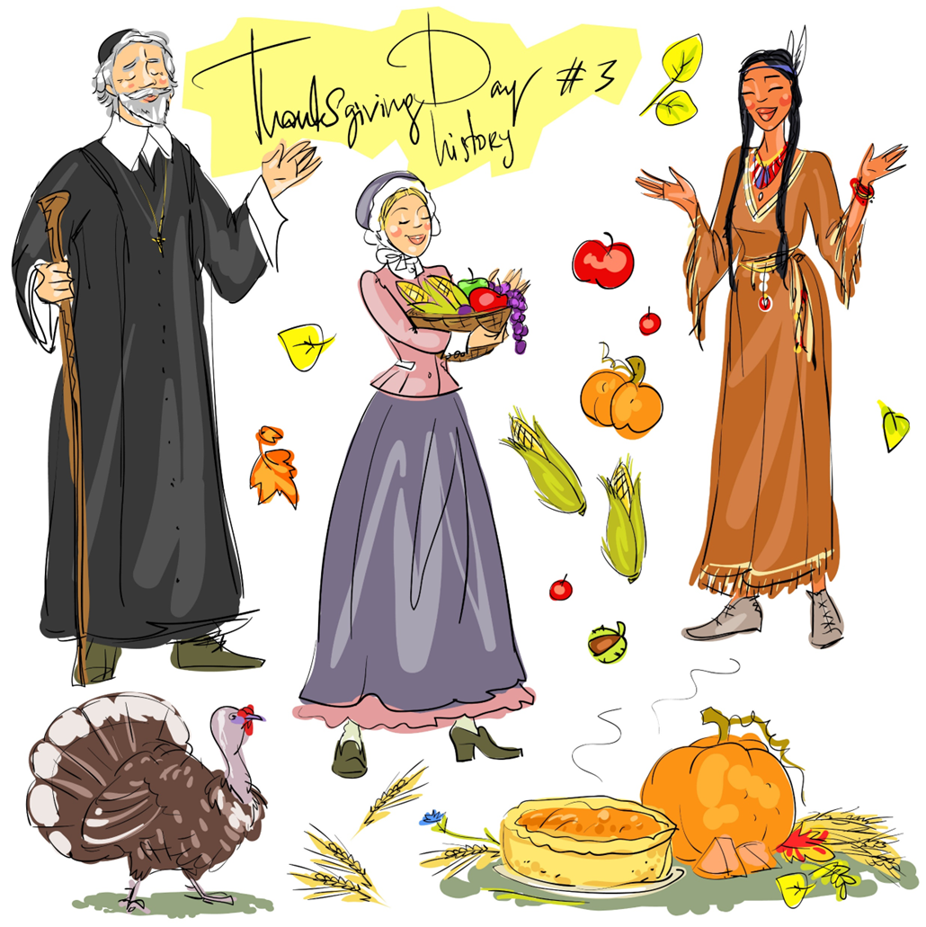
2
6
1
7
5
3
4

Slide 4



Slide 5
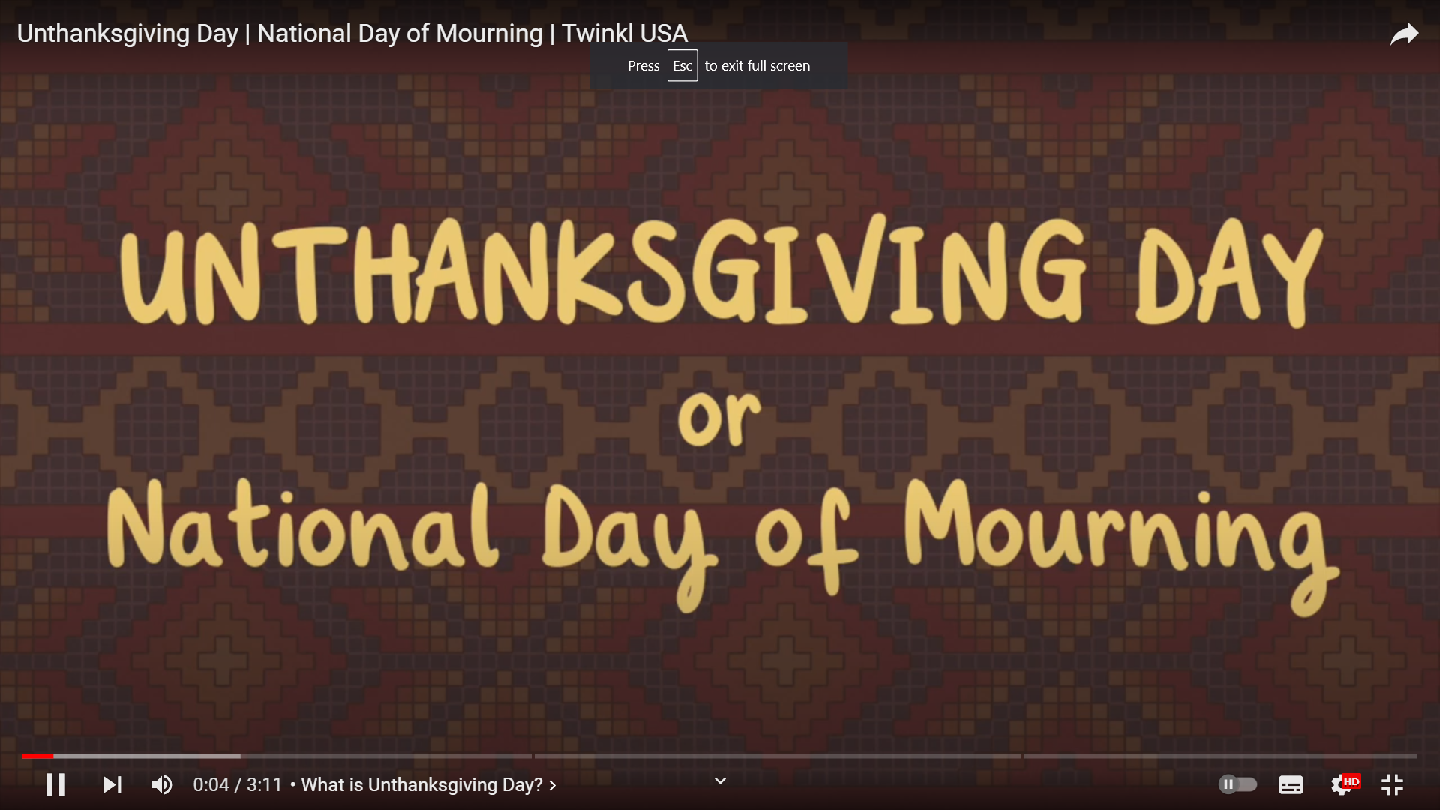
https://www.youtube.com/watch?v=iCcWzMzM6ns&ab_channel=TwinklTeachingResources%7CEducationVideos%7CUSA

